Slide 1

6420 Internet & Web Development
Week 1 Session 1

Slide 2
Contents of This session
Lecture information
Course Schedule
Marking scheme and Assignments
Textbooks & Software
Overview of Internet and WWW

Slide 3
Lecture Information
Master of Computer and Information Science (First Class Honours) Auckland, New Zealand
Bachelor of Computer Engineering, Auckland, New Zealand
Software Engineer (fulltime)
Name
Asra Rahimi
Email
arahimi@unitec.ac.nz

Slide 4
Rules
Classrooms are a learning environment
What does this mean?
You are meant to make mistakes
You have access to computers for a reason
Collaboration and interaction by design
Respect your peers
They are here to learn, just like you

Slide 5
Purpose and Outcomes

Slide 6
Learning Outcomes

Slide 7
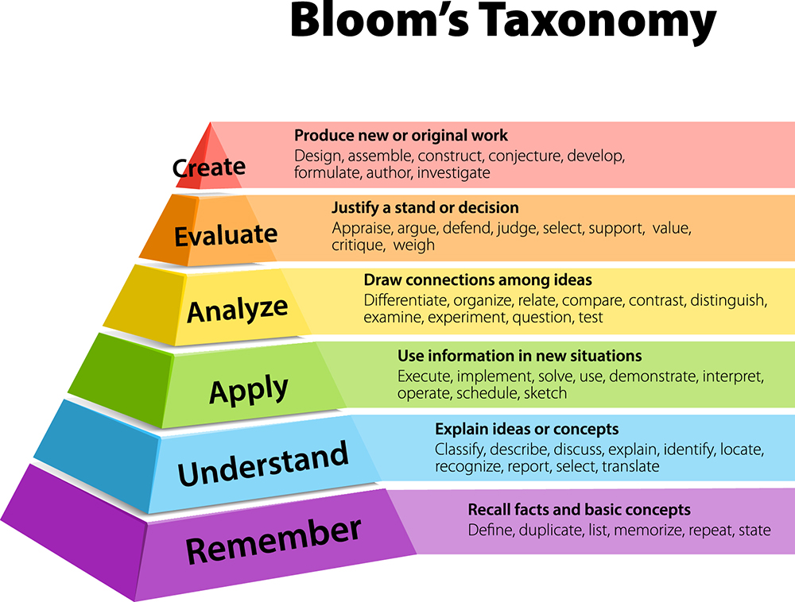
Bloom’s taxonomy
Describes different levels of thinking, academically
Level 5:
Remember – learning information and recalling it
Understand – Contextualising information and explaining directly
Apply – utilise learned information in a practical manner
Level 6:
Level 5
Analyse – usually in an exam or report scenario
https://www.krausanderson.com/wp-content/uploads/2016/09/Bloom.jpg

Slide 8
Learning Support
Support services are available to you:
MAIA – Maori support centre, Maori learning advisors
The Pacific Centre – Pacific learning advisors, 110-1040
International learning advisors
Access4Success – Disability Support services
Many, many more
All student support services can be accessed via Student Support as well
https://www.unitec.ac.nz/current-students/student-services

Slide 9
An overview of Internet & website Development
Provide basic and advanced knowledge of web development including HTML, CSS, JavaScript
Focus on practising real world tasks in web development
By the end, you should be able to work as Front End Web Developer

Slide 10
Course Schedule
Available on Moodle: https://moodle.unitec.ac.nz/

Slide 11
Marking scheme & Assignments
Assignment 1(20%)
Individual implementation of an interactive website to demonstrate your skills in HTML,CSS and JavaScript
Lab Test (30%)
Individual test to demonstrate client side techniques
Assignment 2(50%= 40% project +10% independent work)
A group project

Slide 12
Course Prescription
Hours directed: | Hours Self-directed: | Total Learning Hours:
32.5 | 117.5 | 150

Slide 13
Each Week Time Allocation ( in Hours)
Hours directed: | Independent work | Project
3 | 3 | 6.5-7

Slide 14
About test
Independent work tasks – is the best way to be ready for test.
Test task will be similar to you Independent work

Slide 15
Textbooks & Software
Learning Web Design, 4th Edition
Jennifer Niederst Robbins
Web Style Guide
Patrick Lynch & Sarah Horton
JAVASCRIPT & JQUERY Interactive Front-End Web Development
JON DUCKETT
Don't Make Me Think! A Common Sense Approach to Web Usability
Steve Krug

Slide 16
Textbooks & Software
Software
Text Editor: Notepad++, Sublime Text
Better choice - IDE: VS Code, Atom, Webstorm, PyCharm
Server and Network drive
Hyperdics server
H:\Business\DISC\6420 IWD
Reference site
W3schools

Slide 17

Overview of Internet & WWW
Internet
a global system of interconnected computer networks that use the standard Internet protocol suite (TCP/IP) to link several billion devices worldwide
Interconnected network of computers
Server
PC
IP Address 202.50.208.33
TCP/IP
IP Address 64.233.167.99

Slide 18
Overview of Internet & WWW
WWW
an information system of interlinked hypertext documents and other digital resources that are accessed via the Internet
I want vacation.html
Search for vacation.html
Client
HTTP Request
Server
IP Address 202.50.208.33
IP Address 64.233.167.99
HTTP Response
Display vacation.html
Send back vacation.html

Slide 19
Overview of Internet & WWW
Core components
A Uniform Resource Locator (URL) to uniquely identify a resource on the WWW.
The Hypertext Transfer Protocol (HTTP) to describe how requests and responses operate.
A web server that can respond to HTTP requests.
Hypertext Markup Language (HTML) to publish documents.
A browser that can make HTTP requests from URLs and that can display the HTML it receives

Slide 20
References
https://www.w3schools.com/

